Slide 1


Cloud Engineering
Hands on Computing resources

Slide 2
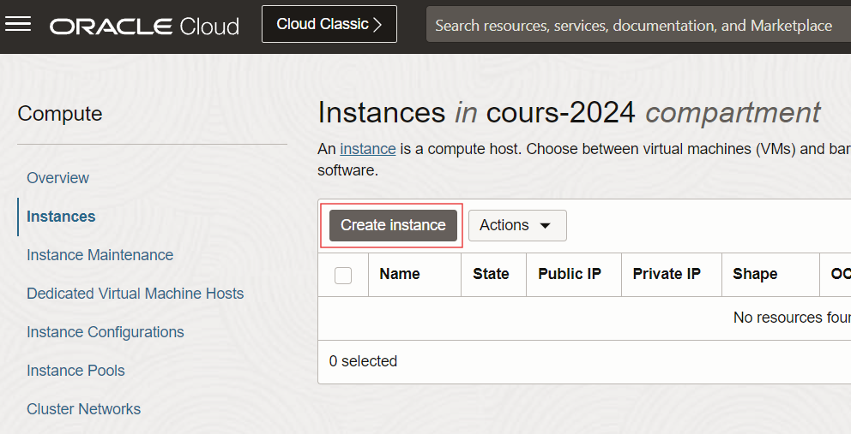
Create a FREE VM
From the top left hamburger menu
Compute
Instances
From the left entries
select the TP compartment
Create a new instance
image: ubuntu (NOT minimal)
shape: xxx.micro (free tier eligible)
in the TP compartment
Save the private ssh key
add a tag (advanced options)
key: created-by
value: your name

Slide 3
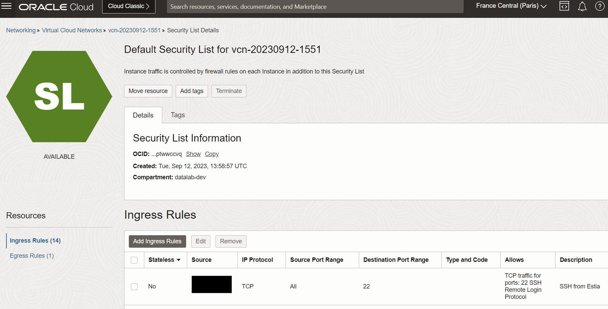
Expose a PORT of the VM to internet
Get your public IP from https://4.ident.me
Go to the VMs Subnet
Select the subnet’s Security list
Add an Ingress Rule, setup:
CIDR <your IP>/32 as source
22 as destination port
Close the port at the end of the session

Slide 4
Connect via SSH to the FREE VM
Get the public IP of your new VM
Open a terminal on your PC or a Cloud Shell
Put the private key in ~/.ssh
Give it the correct rights with chmod 400 ~/.ssh/you_key_file
Connect: ssh –i ~/.ssh/you_key_file ubuntu@public_ip

Slide 5
Launch a web server on the VM and access it
From the ssh terminal in the VM, install docker
Start a nginx docker container with port mapping option
docker inspect to know the container port
use 4444 as host port
Browse to http://<public IP of your VM>:4444 and observe what happens
Add an Ingress Rule with the port 4444
Refresh http://<public IP of your VM>:4444
Remove the ingress rules at the end of the session

Slide 6
Create a FREE VM AS CODE: part 1 subnet
See NETWORK ORGANISATION slide from the network module
Use the skeleton repo tp-cloud-iac-template
Create a pulumi resource of type oci.core.Subnet
Put it in the tp compartment
Name it <env>-pulumi-subnet
Use the range 10.0.X.0/24
Use the OCID of your default VCN (the high level network)
Type pulumi preview to check
commit & then apply the change with pulumi up
DOC https://www.pulumi.com/registry/packages/oci/api-docs/core/subnet/#inputs

Slide 7
Create a FREE VM AS CODE
Create a pulumi resource of type oci.core.Instance
Put it in the tp compartment
Use a shape always free
Use ubuntu image
Set the usual tags
Type pulumi preview to check
commit & then apply the change with pulumi up

Slide 8
Execute some code in a FAAS
Samples of code
From the top left hamburger menu
Developer services
Functions / Applications
Create an application
Drop the code from tp-cloud-iac-template/faas, you could have tested it in local before
add a tag (advanced options)
key: created-by
value: your name
Execute the function with an input named my-input
Observe the response & logs

Slide 9
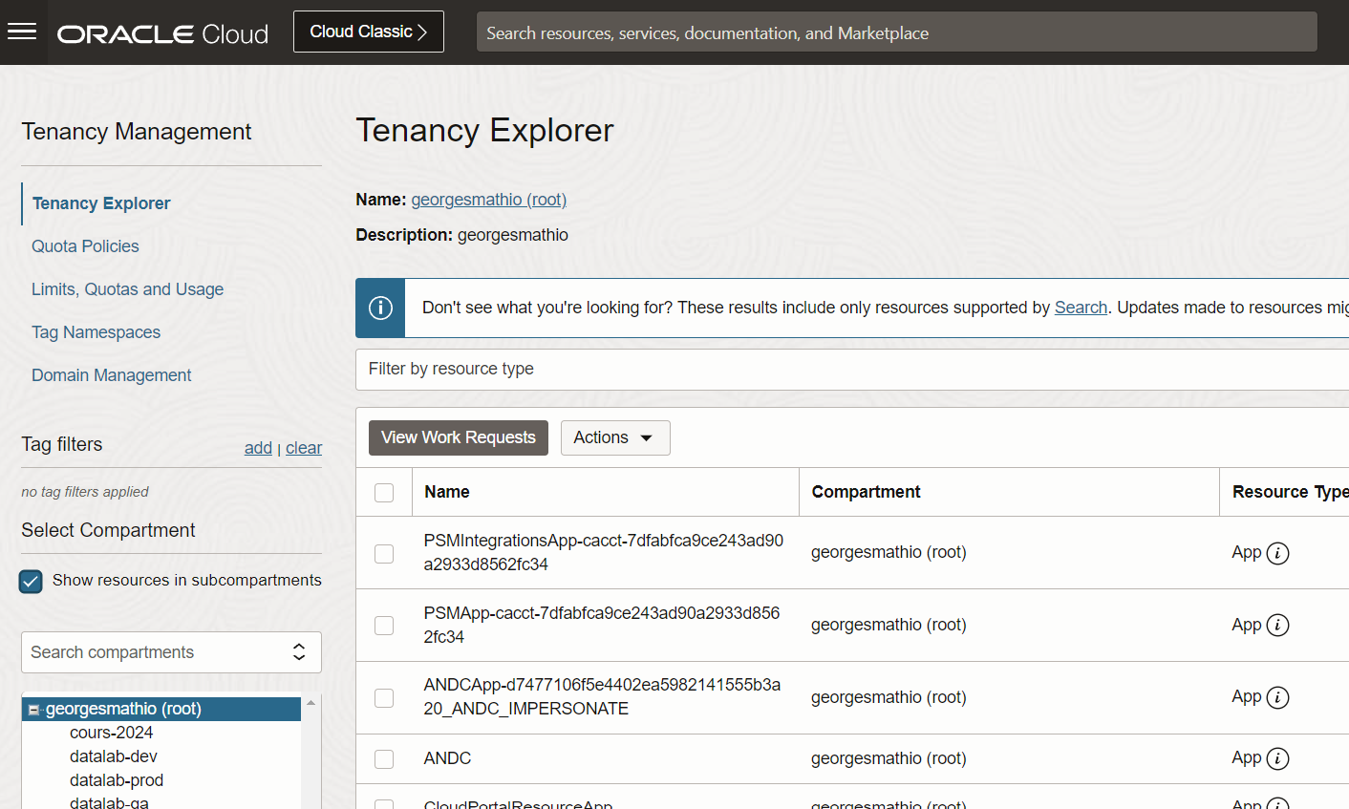
List all the resources with the UI
From the top left hamburger menu
Governance & Administration
Tenancy management
To see everything at once:
Select Show resources in subcompartments
Sort the resources by type
Find the instances (VMs) and shut them down

